Slide 1


OPTIMISING THE CRAFT BEER PORTFOLIO
Strategies for Margin Protection
and Market Growth
Data-Driven Insights and Recommendations
Presented by Team Members | 20th April 2026

Slide 2




Executive Summary
Key findings and strategic direction
Despite $4.31M total revenue, YoY growth has contracted by 0.4%. A strategic realignment of promotions and product focus is needed.
Pricing & Discounts
Product Performance
Regional Variance
High discount levels erode margins to ~35% without generating enough volume to offset the loss.
IPAs & Lagers drive highest margins (~44-47%), outperforming sweeter profiles (Fruit/Sour, Strong Ale) at ~38%.
Coastal regions thrive via Casual Drinkers & Enthusiasts. Mountain & Southwest drag national averages.
Shift focus toward IPAs/Lagers, restructure discount tiers, and reposition in underperforming Southern markets.
1

Slide 3
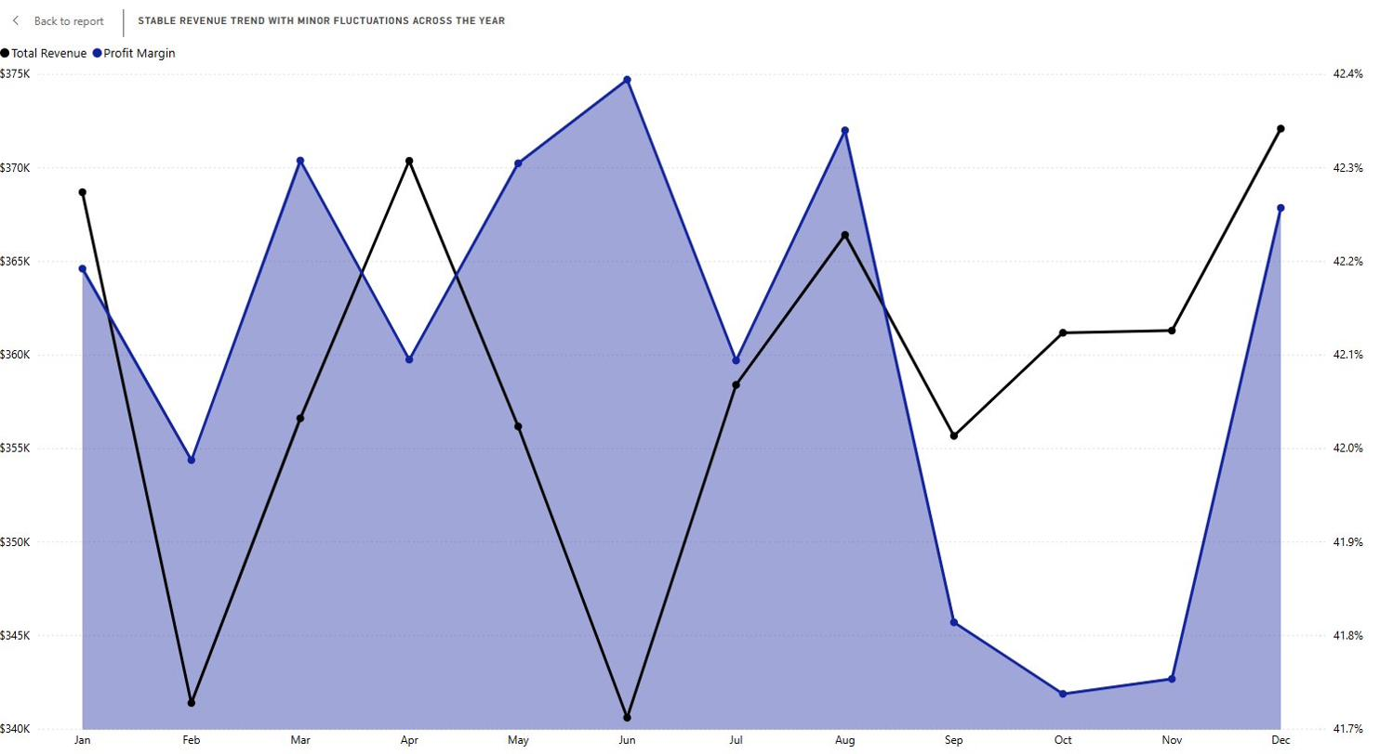

Problem Overview & Business Question
THE CONTEXT
THE PROBLEM
Our company distributes a diverse craft beer portfolio across multiple U.S. regions and sales channels.
Stagnant YoY growth with varying performance across products and regions. We need clarity on profit drivers vs. drags.
How should the company optimise its beer portfolio to maximise profit margins and drive regional growth?

Slide 4
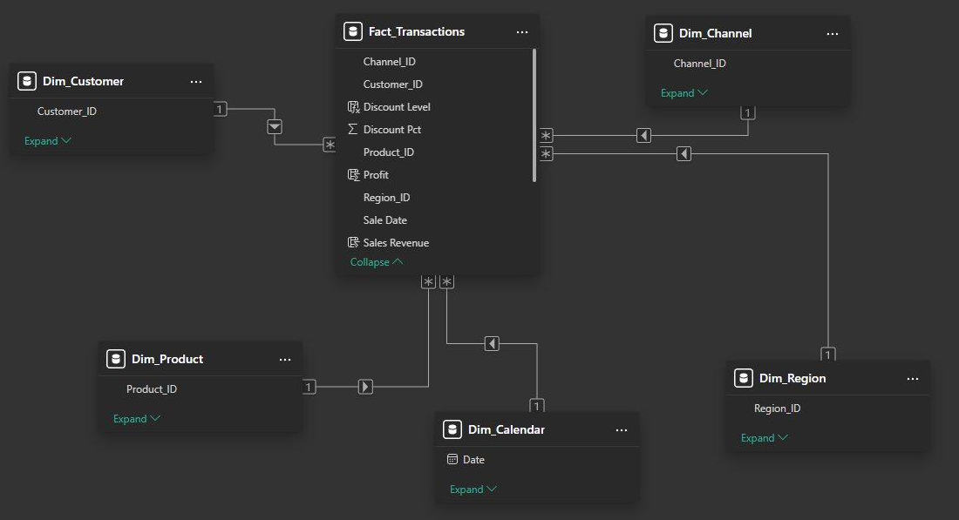
Dataset & Methodology
Data preparation, modelling, and analytical approaches
Star Schema Data Model
01
Data Preparation
Reviewed data dictionary, corrected data types, split Style column into Primary Style and Family.
02
Star Schema Model
Fact_Transactions as central table, linked to Customer, Product, Calendar, Region & Channel dimensions.
03
DAX Measures
Total Revenue, Total Profit, Profit Margin, Units Sold, Avg. Unit Revenue, Transactions, YoY Growth.
TOOLS & APPROACH
04
Dashboard Design
Power BI
Dashboard, DAX, interactive slicers
Star Schema
1 fact table + 5 dimension tables
Interactive visuals with slicers, visual hierarchy, and pre-attentive design to highlight key patterns.
3

Slide 5

Revenue & Sales Overview
Key performance indicators at a glance
$4.31M
561K
$7.68
Total Revenue
Total Units Sold
Avg. Unit Revenue
-0.4%
42.11%
11K
Revenue Growth (YoY)
Profit Margin
Total Transactions
Revenue is strong but growth has stalled. Avg. unit revenue ($7.68) sits below original price ($8.43), indicating discount-driven margin compression that needs addressing.
4

Slide 6
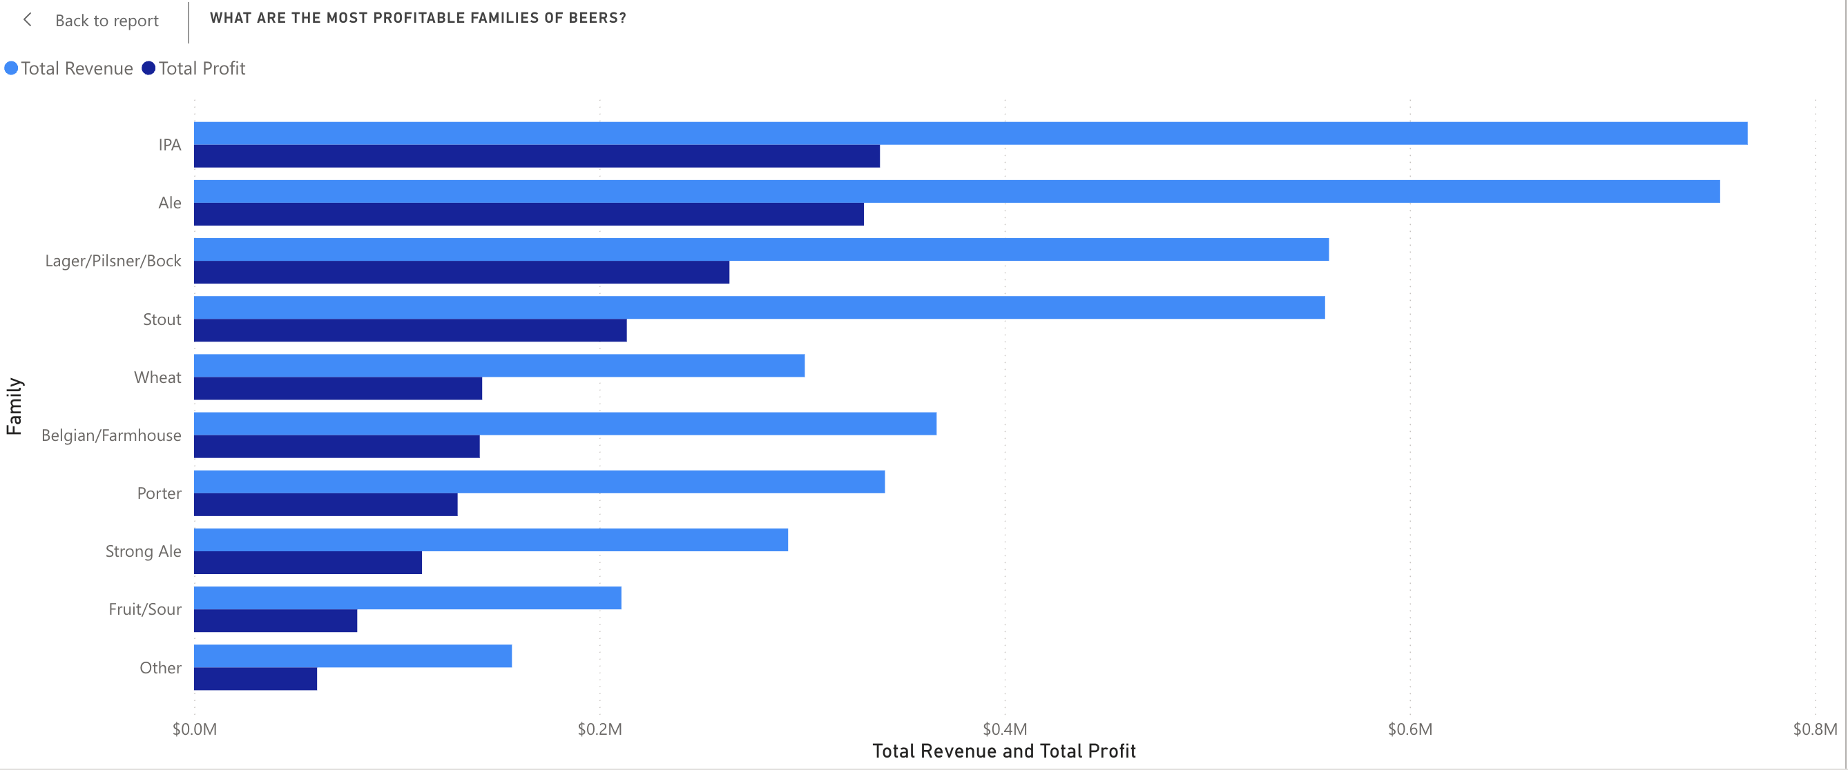
Product Performance by beer family
Revenue & margin contribution across beer family
KEY INSIGHTS
17.8%
IPA dominates as the top revenue contributor
17.5%
Ale is the second strongest beer family by revenue share
~47%
Lager/Pilsner/Bock and Wheat deliver the highest profit margins
IPA ≠ Margin
Discounts erode IPA profitability despite high revenue
Below Median
Underperforming styles need repositioning or phase-out
5

Slide 7
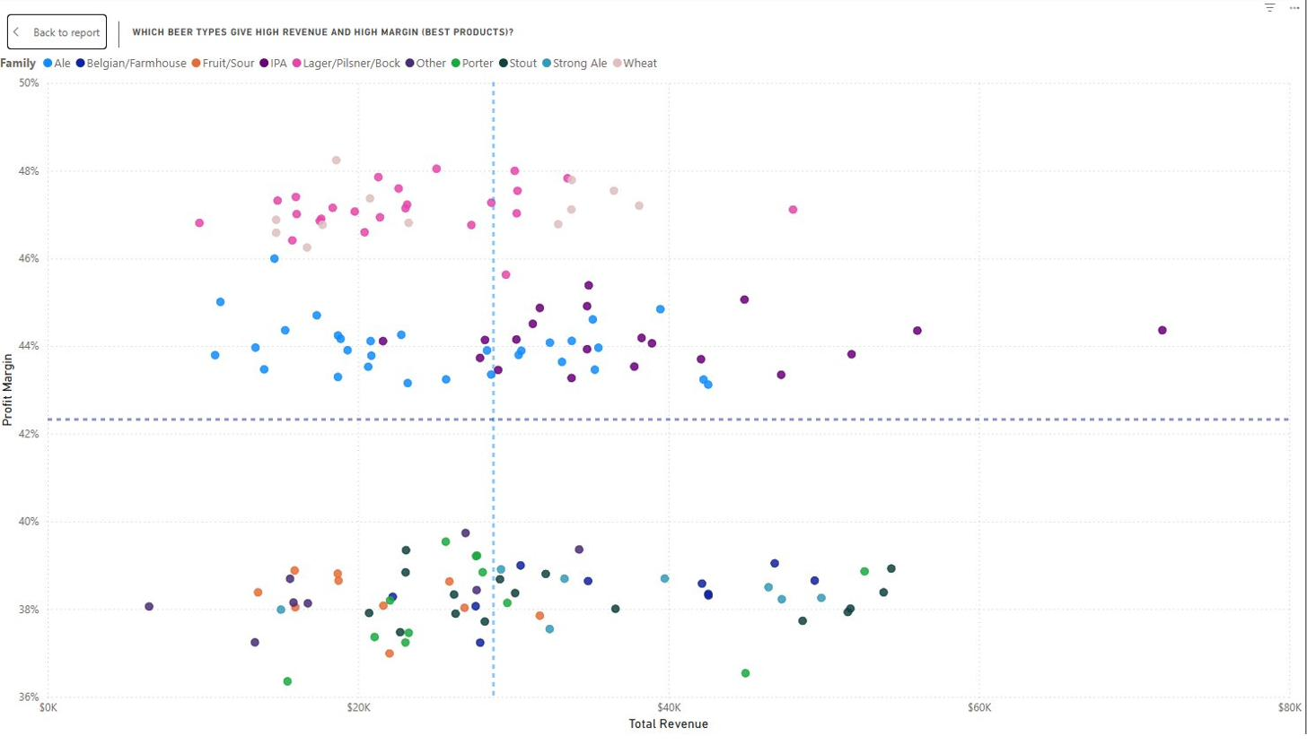
Portfolio Decisions: Revenue, Margin & Product Traits
Profitability shaped by ABV, flavour profile, and review performance
KEY TAKEAWAY
High revenue does not always mean high profit margin.
Some beer families sell more but are not the most profitable. Product traits help explain these differences.
MARGIN LEADERS
Lager/Pilsner/Bock
47.2%
Wheat
47.2%
IPA
44.2%
Ale
43.9%
Balance revenue, margin, and product characteristics when making portfolio decisions.
6

Slide 8
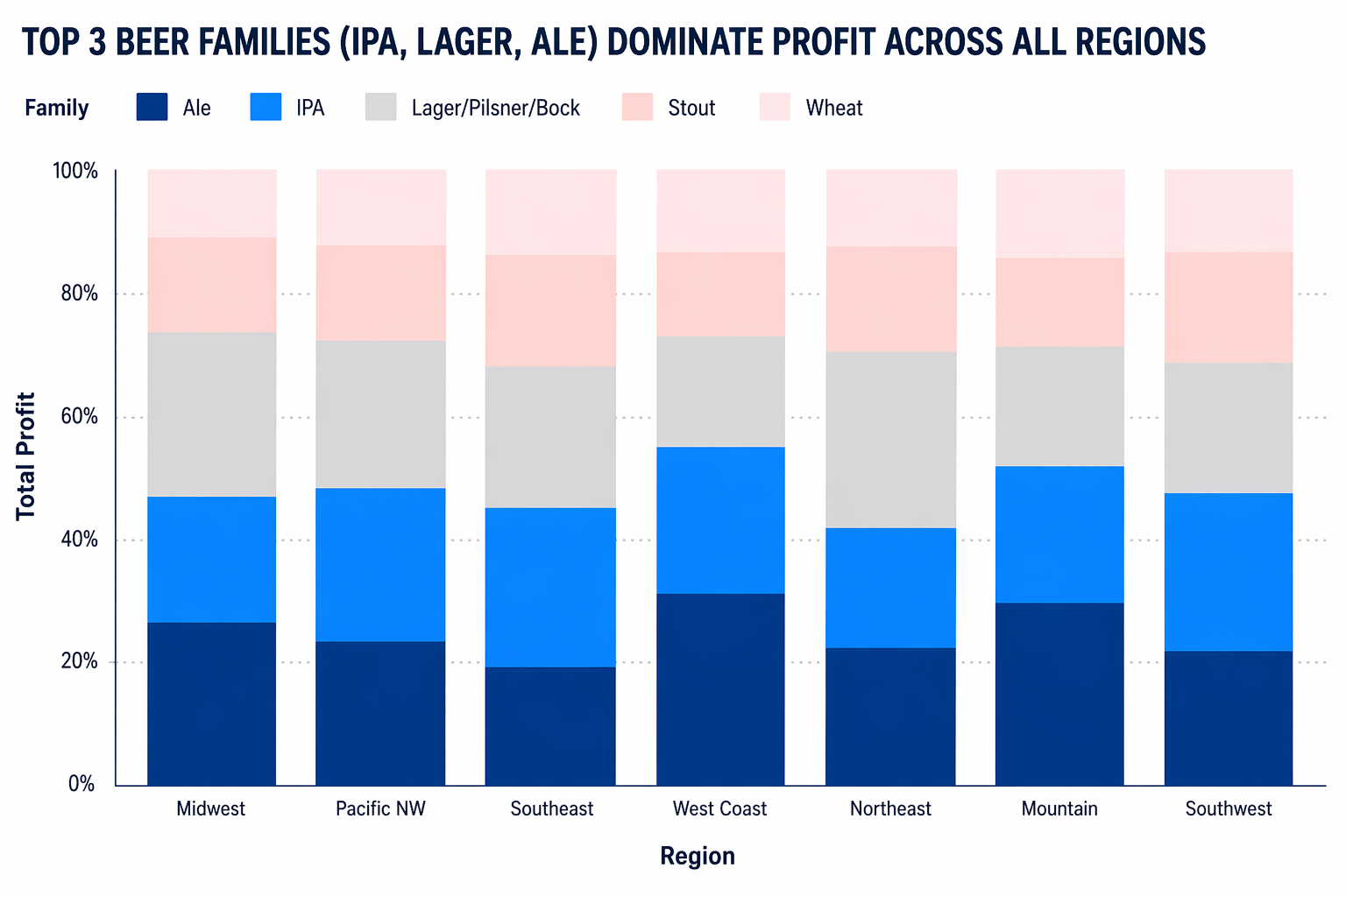

Regional Demand & Customer Segments
How preferences and customer types shape profitability
REGIONAL PATTERNS
Ale, IPA & Lager drive profit in all regions
Pacific NW: experimental craft beer culture
Midwest: traditional, light, familiar styles
Local preferences influence which products should be emphasized
Casuals drive volume; craft drives higher-margin sales
KEY CUSTOMER SEGMENTS
Casual Drinkers
30.48% | $552.9K
Craft Enthusiasts
26.44% | $479.8K
Hospitality Buyers
15.29% | $277.4K
Premium Explorers
14.79% | $268.3K
Core beer families dominate across regions, but local preferences influence their profitability mix
Convenience Buyers
13.00% | $235.9K
7

Slide 9

Channel Performance Across Regions
Volume vs. margin trade-off and regional performance
Region | Off-Premise Revenue | Off-Premise Margin | On-Premise Revenue | On-Premise Margin
Southwest | $217.89K | 41.1% | $119.01K | 45.4%
Southeast | $464.08K | 41.1% | $241.40K | 45.3%
West Coast | $460.97K | 40.8% | $244.57K | 45.0%
Midwest | $473.20K | 40.6% | $240.23K | 45.3%
Mountain | $248.10K | 40.1% | $122.10K | 45.6%
Pacific NW | $492.09K | 40.3% | $244.58K | 44.8%
Northeast | $485.95K | 40.0% | $254.52K | 45.0%
Off-Premise
~2x higher revenue than on-premise. Volume-driven channel.
On-Premise
Higher margin (~45% vs ~40%). Margin-driven channel.
Weak Regions
Mountain & Southwest underperform across both channels. Possible execution issues.
Match product selection and pricing to each channel — volume in off-premise, margin in on-premise — while investigating weak regions.
8

Slide 10


Limitations & Alternate Perspectives
Acknowledging analytical boundaries
LIMITATIONS
ALTERNATE PERSPECTIVE
The dashboard shows patterns, but not direct cause-and-effect.
Lower-margin products may still support variety or niche demand.
External factors such as competitors, marketing, and customer loyalty are not included.
Some weaker products may benefit from repositioning rather than removal.
Family-level analysis may hide product-level differences.
Findings should guide decisions, but not act as absolute rules.
9

Slide 11



Strategic Recommendations: Product Actions
Portfolio optimisation to protect margins and drive growth
Prioritise High-Margin Styles
Restructure Discount Tiers
Increase shelf space and promotional support for IPAs, Lagers, and Wheat Beers which deliver 44-47% margins. These should be the portfolio anchor.
Cap deep discounts that erode margins to ~35%. Implement tiered pricing: small discounts for trial, loyalty rewards for repeat purchase — not blanket markdowns.
Reposition Underperformers
Leverage Product Characteristics
Fruit/Sour and Strong Ale (~38% margin) need repositioning — consider seasonal limited releases or premium branding rather than phase-out, to preserve portfolio variety.
Use flavour data (bitterness, hoppiness, sweetness) and review scores to guide new product development and curate regional assortments that match local preferences.
10

Slide 12



Strategic Recommendations: Operational Actions
Regional execution and channel optimisation
Investigate Sunbelt Underperformance
Optimise Channel Strategy
Mountain & Southwest regions lag on both revenue and margin. Conduct field audits on pricing execution, distribution coverage, and product mix alignment.
Off-premise for volume (broaden assortment), on-premise for margin (premium SKUs, higher pour prices). Tailor product selection per channel type.
Double Down on Strong Markets
Build a Regional Test Framework
Coastal regions (Northeast, West Coast, Pacific NW) are thriving. Increase investment in Casual Drinker and Craft Enthusiast segments where spend per purchase is highest.
Pilot new product launches and pricing strategies in strong markets before rolling out nationally. Use A/B testing on discount levels to find the optimal margin-volume balance.
11

Slide 13


THANK YOU
KEY TAKEAWAYS
IPAs, Lagers & Wheat Beers are the margin leaders — prioritise and protect them
Discount restructuring is critical — deep discounts erode margins without sufficient volume uplift
Coastal markets are strong; Sunbelt regions need investigation and intervention
Channel strategy must differentiate — volume through off-premise, margin through on-premise
Questions & Discussion
We welcome your feedback and next-step discussion.
12

Slide 14
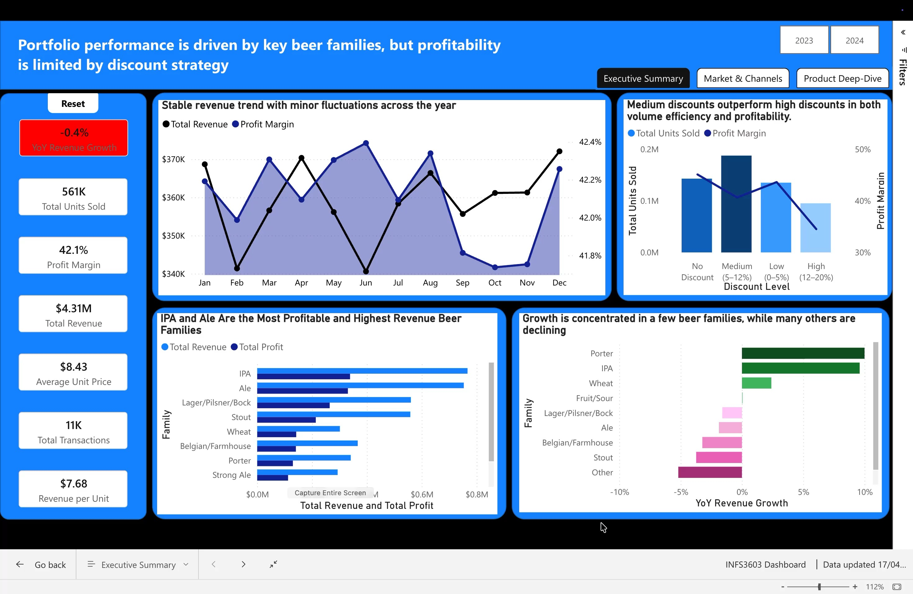
Dashboard Demonstration
This interactive Power BI dashboard was developed to provide management with visibility into product performance, profitability, customer segments, regional demand patterns, and channel effectiveness.
11

Slide 15

Dashboard Demonstration
This interactive Power BI dashboard was developed to provide management with visibility into product performance, profitability, customer segments, regional demand patterns, and channel effectiveness.
11

Slide 16
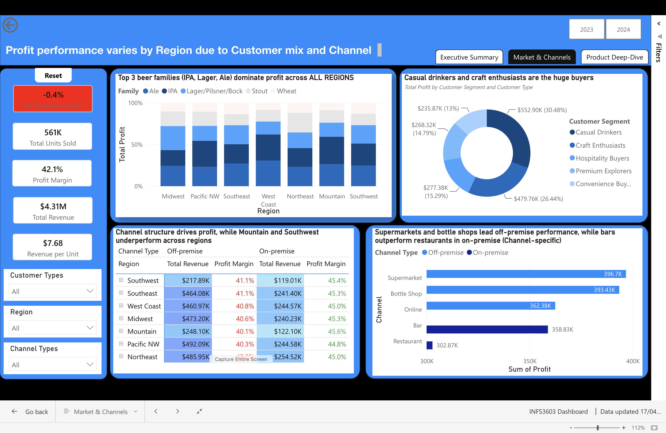
Dashboard Demonstration
This interactive Power BI dashboard was developed to provide management with visibility into product performance, profitability, customer segments, regional demand patterns, and channel effectiveness.
11

Slide 17
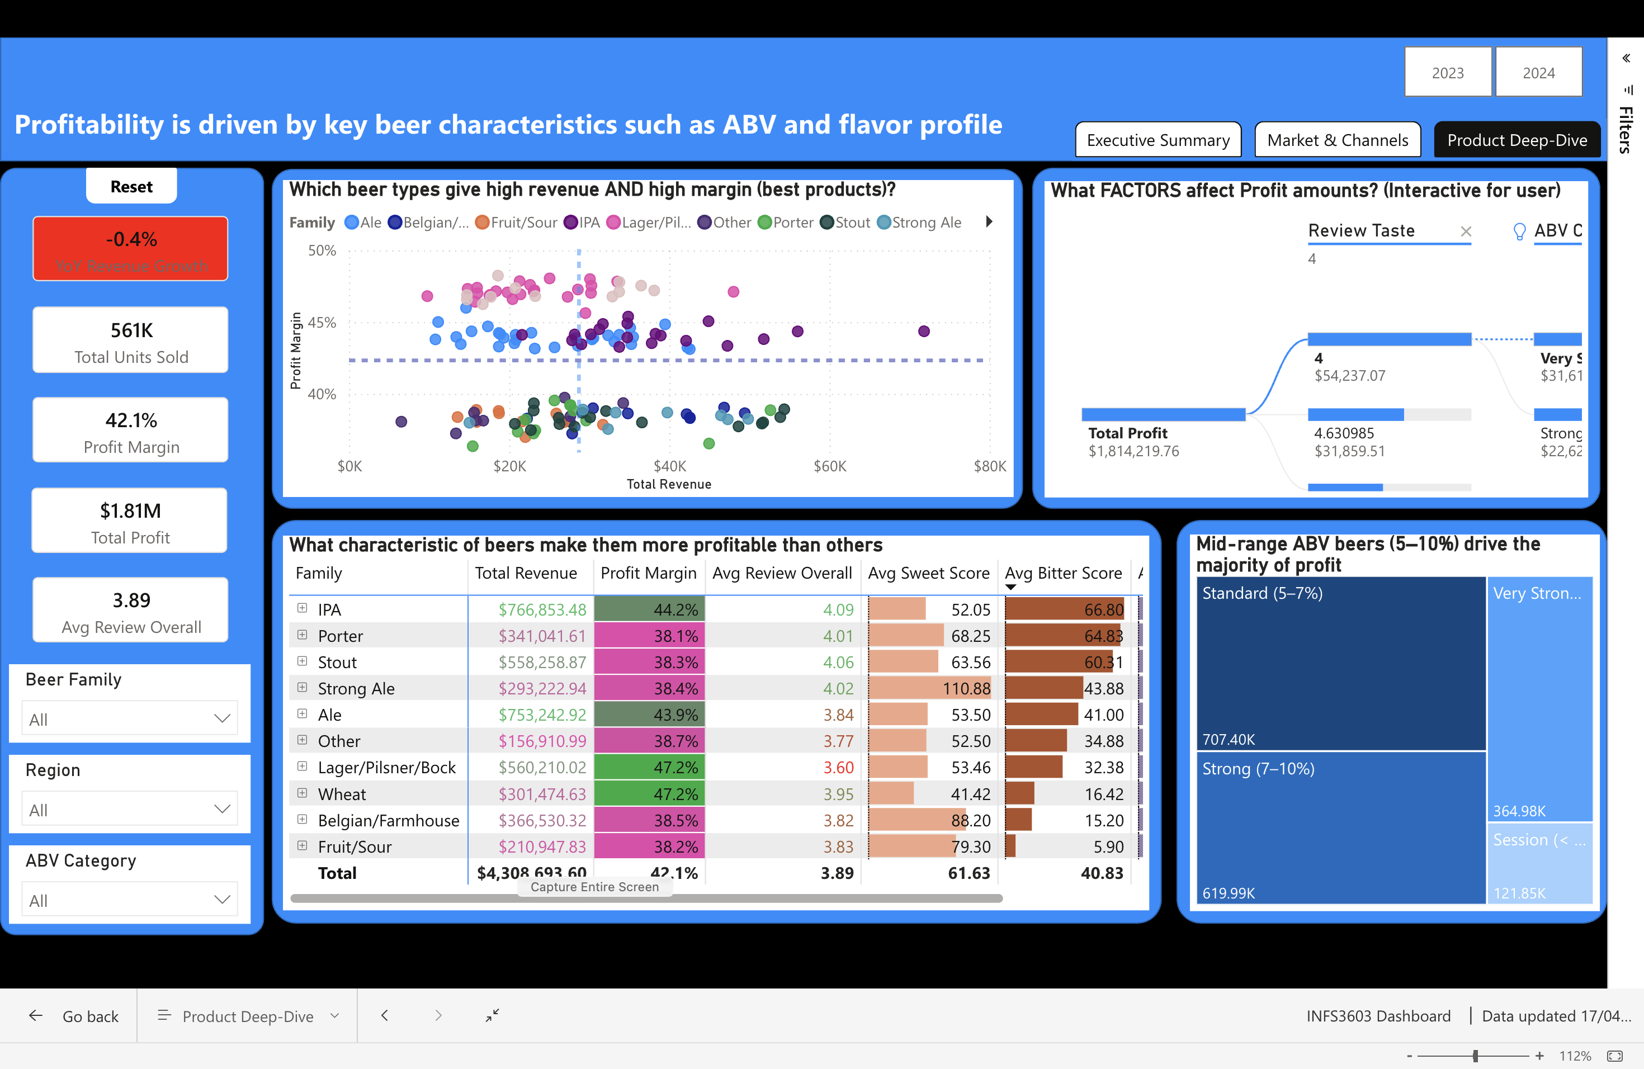
Dashboard Demonstration
This interactive Power BI dashboard was developed to provide management with visibility into product performance, profitability, customer segments, regional demand patterns, and channel effectiveness.
11

